Slide 1
CS 4320 / 7320 Software Engineering
Software Engineering Lifecycle
& Basic Concepts

Slide 2
CS 4320 / 7320 Software Engineering
Software Engineering Lifecycle
& Basic Concepts

Slide 3
Software Engineering
What is engineering, as a discipline?
What is software?
What are the consequences of poor engineering?

Slide 4
Software Engineering
What is engineering, as a discipline?
“The application of scientific, economic, social, and practical knowledge in order to design, build, and maintain structures, machines, devices, systems, materials and processes”
- wikipedia

Slide 5
Software Engineering
What is software?
Computer programs and related documentation of requirements, designs, models, and manuals.
- Sommerville

Slide 6
Software Engineering
What are the consequences of poor engineering?
Horrible, horrible consequences!!!
Engineering Failures

Slide 7
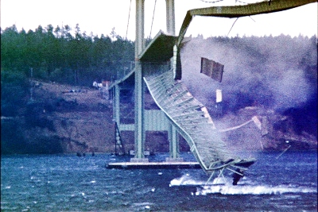
Engineering Failures
What are the consequences of poor engineering?
Source: http://en.wikipedia.org/wiki/File:TacomaNarrowsBridgeCollapse_in_color.jpg

Slide 8
Engineering Failures
What are the consequences of poor engineering?
Tacoma Narrows Bridge Collapse (1940):
42 mph winds
http://www.wsdot.wa.gov/tnbhistory/machine/machine3.htm
Poor engineering practices did not account for aerodynamics of suspension bridge design
See:
http://upload.wikimedia.org/wikipedia/commons/1/19/Tacoma_Narrows_Bridge_destruction.ogg

Slide 9
Engineering Failures
What are the consequences of poor engineering?
But, what about today, with current computer modeling techniques?
2007 I-35 bridge collapse in Minneapolis
“An employee of the NTSB had written his doctoral thesis on possible failure scenarios of this specific bridge while he was a student at the nearby University of Minnesota. That thesis, including his computer model of the bridge for failure mode analysis, was used by the NTSB to aid in their investigation.”
http://en.wikipedia.org/wiki/I-35W_Mississippi_River_bridge

Slide 10
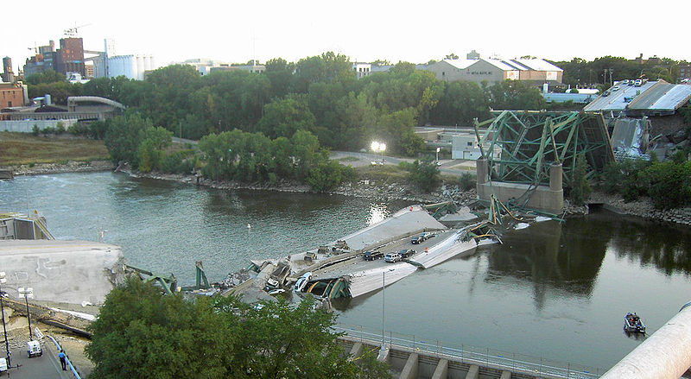
Engineering Failures
Source: http://en.wikipedia.org/wiki/File:I35_Bridge_Collapse_4crop.jpg

Slide 11
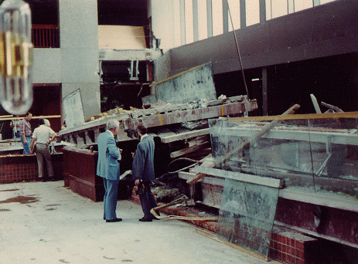
Engineering Failures
What are the consequences of poor engineering?
Hyatt Regency, KCMO
An elevated walkway
gathered a crowd
watching a dance below.
The static load of crowd
= failure
Source: http://en.wikipedia.org/wiki/File:Hyatt_Regency_collapse_floor_view.PNG

Slide 12
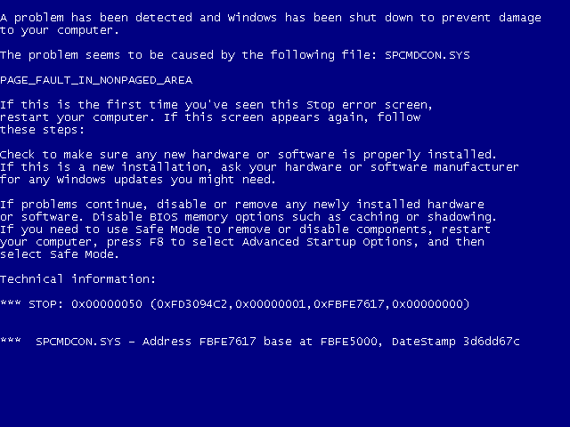
Engineering Failures
What about when software fails?
Windows XP
Blue Screen of
Death
Frustrating
Source: http://en.wikipedia.org/wiki/File:Windows_XP_BSOD.png

Slide 13
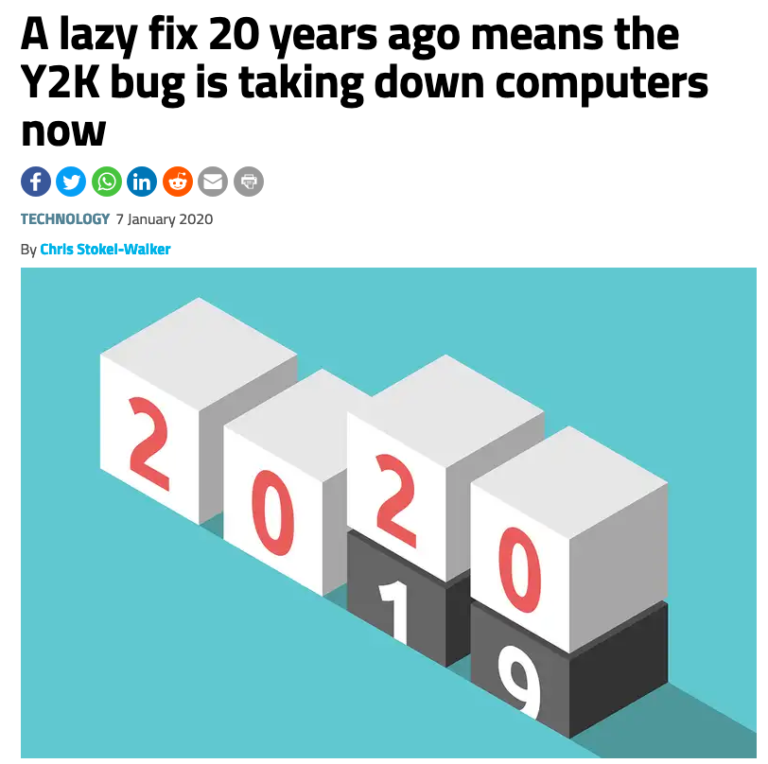
Recent Software Engineering Failures

Slide 14
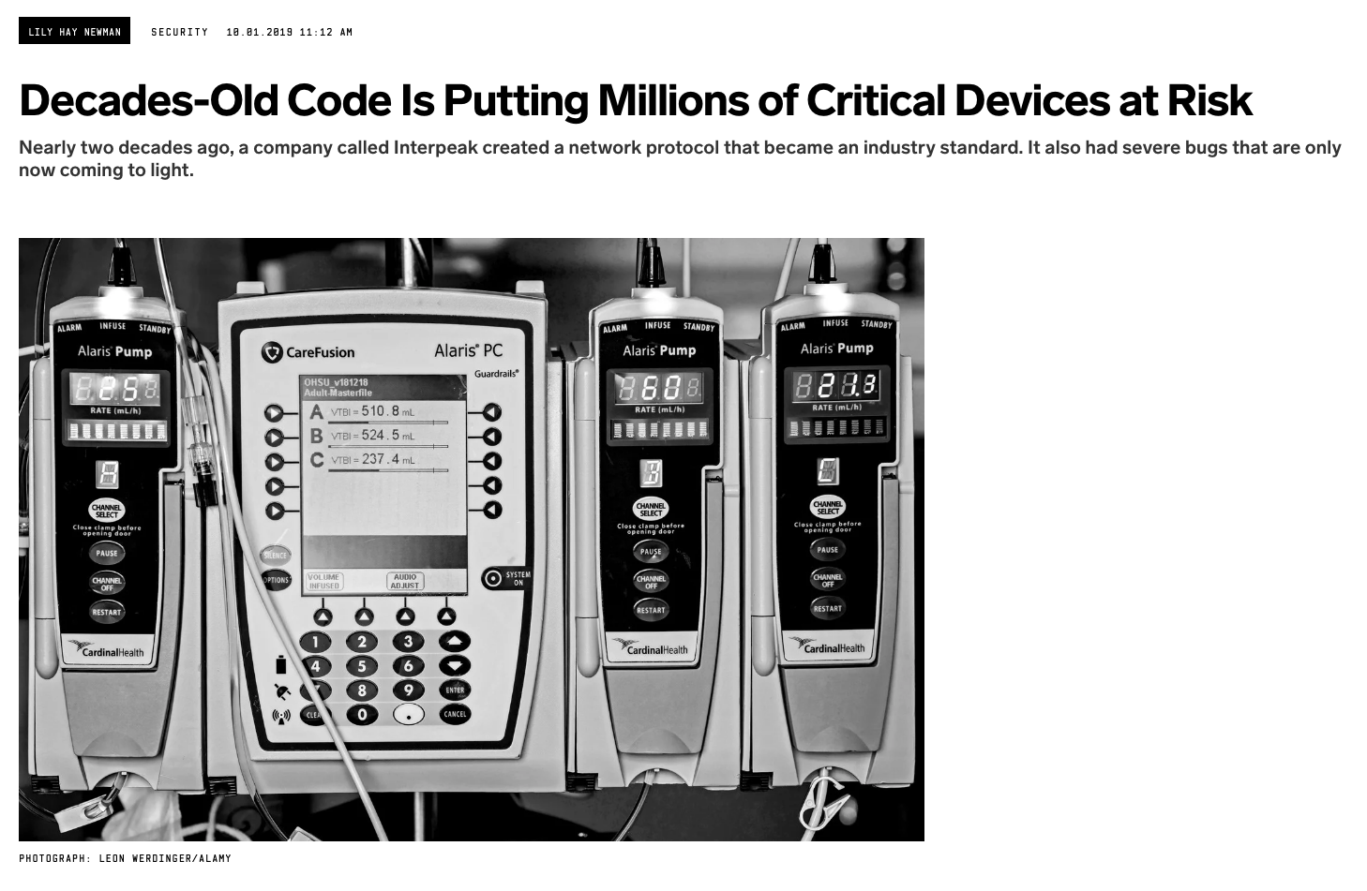
Recent Software Engineering Failures
https://www.wired.com/story/urgent-11-ipnet-vulnerable-devices/

Slide 15
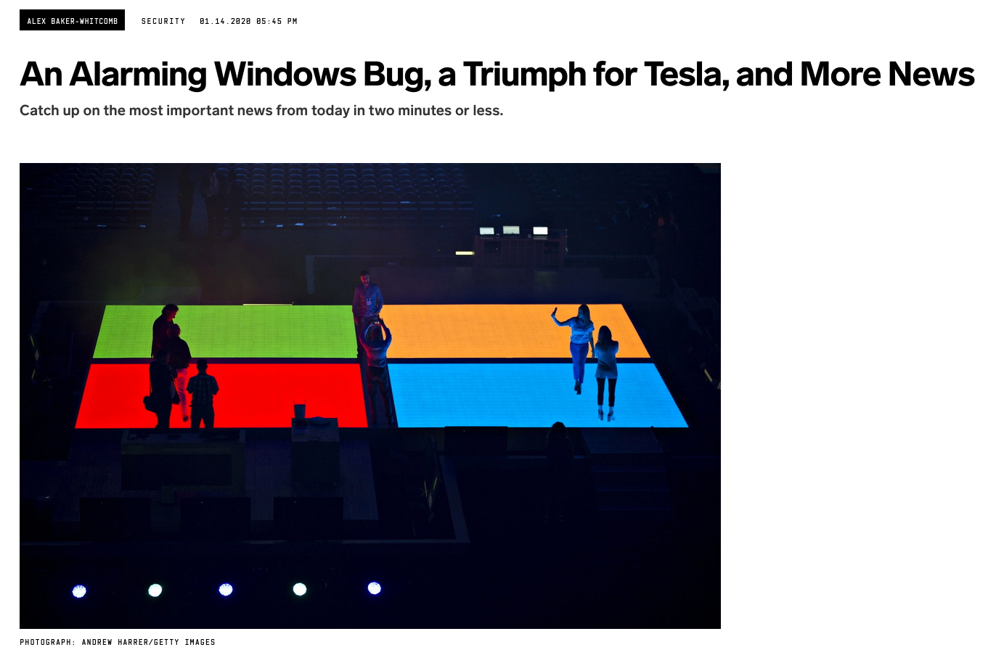
Recent Software Engineering Failures
https://www.wired.com/story/tesla-stock-windows-10-vulnerability-nsa-microsoft/

Slide 16
Engineering Failures
… or very costly! '' Date: 9/1997
(By James Gleick) It took the European Space Agency 10 years and $7 billion to produce Ariane 5, a giant rocket capable of hurling a pair of three-ton satellites into orbit with each launch and intended to give Europe overwhelming supremacy in the commercial space business.
All it took to explode that rocket less than a minute into its maiden voyage last June, scattering fiery rubble across the mangrove swamps of French Guiana, was a small computer program trying to stuff a 64-bit number into a 16-bit space.
...
This shutdown occurred 36.7 seconds after launch, when the guidance system's own computer tried to convert one piece of data -- the sideways velocity of the rocket -- from a 64-bit format to a 16-bit format. The number was too big, and an overflow error resulted. When the guidance system shut down, it passed control to an identical, redundant unit, which was there to provide backup in case of just such a failure. But the second unit had failed in the identical manner a few milliseconds before. And why not? It was running the same software.
''
Source: http://www.cse.lehigh.edu/~gtan/bug/softwarebug.html#ariane

Slide 17
Engineering Failures
… or life threatening! '' Date: 9/14/2004
(IEEE Spectrum) -- It was an air traffic controller's worst nightmare. Without warning, on Tuesday, 14 September, at about 5 p.m. Pacific daylight time, air traffic controllers lost voice contact with 400 airplanes they were tracking over the southwestern United States. Planes started to head toward one another, something that occurs routinely under careful control of the air traffic controllers, who keep airplanes safely apart. But now the controllers had no way to redirect the planes' courses.
...
The controllers lost contact with the planes when the main voice communications system shut down unexpectedly. To make matters worse, a backup system that was supposed to take over in such an event crashed within a minute after it was turned on. The outage disrupted about 800 flights across the country.
...
Inside the control system unit is a countdown timer that ticks off time in milliseconds. The VCSU uses the timer as a pulse to send out periodic queries to the VSCS. It starts out at the highest possible number that the system's server and its software can handle—2^32. It's a number just over 4 billion milliseconds. When the counter reaches zero, the system runs out of ticks and can no longer time itself. So it shuts down.
Counting down from 2^32 to zero in milliseconds takes just under 50 days. The FAA procedure of having a technician reboot the VSCS every 30 days resets the timer to 2^32 almost three weeks before it runs out of digits. ''
Source: http://www.cse.lehigh.edu/~gtan/bug/softwarebug.html#aircontrol

Slide 18
Software Engineering
Software Engineering:
“Engineering discipline that is concerned with all aspects of software production”
- Sommerville
Recall that software is:
Computer programs and related documentation of requirements, designs, models, and manuals.

Slide 19
Software Engineering
Theories, methods and tools for professional software development
Computer Code/Programs
Requirements Documents
Design Documents
Data, Process, and other models
User manuals
In other words; coding is a small portion of software engineering, the majority is technical documentation.

Slide 20
Technical Documents
Software engineering does not exist outside the creation of a variety of technical documents
Analogous to:
Blue prints for construction projects
Logic design and wiring diagrams for hardware fabrication
Models, prototypes, and computer simulations for aircraft and space vehicles
NASA happens to have some of the best software engineers for a reason

Slide 21
Software Engineering
Why is it so important to get software engineering right?
Software engineering is more than just
Designing a solution
Coding a solution
Software engineering is also about process management

Slide 22
Software Engineering
What is the high-level process?
Problem
Requirements
Analysis
Design
Release
Testing
Implementation
Maintenance
Problem

Slide 23
Software Development Lifecycle
Problem: Some entity (program, process, etc) that requires software to be created as the preferred solution.
Requirements: The explicit, well defined, thorough goals of the software - i.e., what should it do?
Design: The detailed plans that will facilitate the construction of computer code to sufficiently solve the problem.

Slide 24
Software Development Lifecycle
Implementation: The construction of the computer program that is a solution to the problem.
Testing: Validating the requirements are met and the outcomes of computer programs match the expectations set forth in the Requirements and Design stages.
Note: Testing can drive further implementation

Slide 25
Software Development Lifecycle
Release: The transition of computer programs from the developers to the users.
Maintenance: The continual upkeep of the software, including computer programs, documentation, requirements, design, testing, and enhancement/bug-fix implementation.
Problem: ?

Slide 26
Software Development Lifecycle
Problem: ???
A problem is the end of all software.
Usually, the software is no longer needed
Obsolete or replaced
New software takes the place of old software, as a clean solution to a problem that is usually different, or broader scoped, than the original problem.
Eventually, all software becomes obsolete.
The hardware that runs the most solid, perfect legacy code is eventually replaced.

Slide 27
Characteristic Goals for SWE
Maintainability:
Designed to evolve to meet the changing needs of the customer
Change is inevitable, hence Change Management
Dependability:
Reliable, performs consistently as expected
Should not cause damage or fail
Security:
Operate with integrity, must be able to trust the results of the software

Slide 28
Characteristic Goals for SWE
Efficiency:
No wasteful consumption of resources, e.g.
network bandwidth, CPU cycles,
RAM, Secondary storage
Responsive to environment and/or users
Acceptability (compatibility):
Software should be designed for the appropriate user base
Does the user understand, and can they efficiently operate the software, compatible with environment

Slide 29
The Software Development Lifecycle

Slide 30
Topics covered
Software process models
Process activities
Coping with change
Process improvement

Slide 31
The software process
A structured set of activities required to develop a software system.
Many different software processes but all involve:
Specification – defining what the system should do;
Design and implementation – defining the organization of the system and implementing the system;
Validation – checking that it does what the customer wants;
Evolution – changing the system in response to changing customer needs.
A software process model is an abstract representation of a process. It presents a description of a process from some particular perspective.

Slide 32
Software process descriptions
When we describe and discuss processes, we usually talk about the activities in these processes such as specifying a data model, designing a user interface, etc. and the ordering of these activities.
Process descriptions may also include:
Products, which are the outcomes of a process activity;
Roles, which reflect the responsibilities of the people involved in the process;
Pre- and post-conditions, which are statements that are true before and after a process activity has been enacted or a product produced.

Slide 33
Plan-driven and agile processes
Plan-driven processes are processes where all of the process activities are planned in advance and progress is measured against this plan.
In agile processes, planning is incremental and it is easier to change the process to reflect changing customer requirements.
In practice, most practical processes include elements of both plan-driven and agile approaches.
There are no right or wrong software processes.

Slide 34
Software process models

Slide 35
Software process models
The waterfall model
Plan-driven model. Separate and distinct phases of specification and development.
Incremental development
Specification, development and validation are interleaved. May be plan-driven or agile.
Integration and configuration
The system is assembled from existing configurable components. May be plan-driven or agile.
In practice, most large systems are developed using a process that incorporates elements from all of these models.

Slide 36
The waterfall model

Slide 37
Waterfall model phases
There are separate identified phases in the waterfall model:
Requirements analysis and definition
System and software design
Implementation and unit testing
Integration and system testing
Operation and maintenance
The main drawback of the waterfall model is the difficulty of accommodating change after the process is underway. In principle, a phase has to be complete before moving onto the next phase.

Slide 38
Waterfall model problems
Inflexible partitioning of the project into distinct stages makes it difficult to respond to changing customer requirements.
Therefore, this model is only appropriate when the requirements are well-understood and changes will be fairly limited during the design process.
Few business systems have stable requirements.
The waterfall model is mostly used for large systems engineering projects where a system is developed at several sites.
In those circumstances, the plan-driven nature of the waterfall model helps coordinate the work.

Slide 39
Incremental development

Slide 40
Incremental development benefits
The cost of accommodating changing customer requirements is reduced.
The amount of analysis and documentation that has to be redone is much less than is required with the waterfall model.
It is easier to get customer feedback on the development work that has been done.
Customers can comment on demonstrations of the software and see how much has been implemented.
More rapid delivery and deployment of useful software to the customer is possible.
Customers are able to use and gain value from the software earlier than is possible with a waterfall process.

Slide 41
Incremental development problems
The process is not visible.
Managers need regular deliverables to measure progress. If systems are developed quickly, it is not cost-effective to produce documents that reflect every version of the system.
System structure tends to degrade as new increments are added.
Unless time and money is spent on refactoring to improve the software, regular change tends to corrupt its structure. Incorporating further software changes becomes increasingly difficult and costly.

Slide 42
Integration and configuration
Based on software reuse where systems are integrated from existing components or application systems (sometimes called COTS -Commercial-off-the-shelf) systems).
Reused elements may be configured to adapt their behaviour and functionality to a user’s requirements

Slide 43
Types of reusable software
Stand-alone application systems (sometimes called COTS) that are configured for use in a particular environment.
Collections of objects that are developed as a package to be integrated with a component framework such as .NET or J2EE.
Web services that are developed according to service standards and which are available for remote invocation.

Slide 44
Reuse-oriented software engineering

Slide 45
Key process stages
Requirements specification
Software discovery and evaluation
Requirements refinement
Application system configuration
Component adaptation and integration

Slide 46
Advantages and disadvantages
Reduced costs and risks as less software is developed from scratch
Faster delivery and deployment of system
But requirements compromises are inevitable so system may not meet real needs of users
Loss of control over evolution of reused system elements

Slide 47
SDLC activities

Slide 48
SDLC activities
Real software processes are inter-leaved sequences of technical, collaborative and managerial activities with the overall goal of specifying, designing, implementing and testing a software system.
The four basic process activities of specification, development, validation and evolution are organized differently in different development processes.
For example, in the waterfall model, they are organized in sequence, whereas in incremental development they are interleaved.

Slide 49
The requirements engineering process

Slide 50
Software specification
The process of establishing what services are required and the constraints on the system’s operation and development.
Requirements engineering process
Requirements elicitation and analysis
What do the system stakeholders require or expect from the system?
Requirements specification
Defining the requirements in detail
Requirements validation
Checking the validity of the requirements

Slide 51
Software design and implementation
The process of converting the system specification into an executable system.
Software design
Design a software structure that realises the specification;
Implementation
Translate this structure into an executable program;
The activities of design and implementation are closely related and may be inter-leaved.

Slide 52
A general model of the design process

Slide 53
Design activities
Architectural design, where you identify the overall structure of the system, the principal components (subsystems or modules), their relationships and how they are distributed.
Database design, where you design the system data structures and how these are to be represented in a database.
Interface design, where you define the interfaces between system components.
Component selection and design, where you search for reusable components. If unavailable, you design how it will operate.

Slide 54
System implementation
The software is implemented either by developing a program or programs or by configuring an application system.
Design and implementation are interleaved activities for most types of software system.
Programming is an individual activity with no standard process.
Debugging is the activity of finding program faults and correcting these faults.

Slide 55
Software validation
Verification and validation (V & V) is intended to show that a system conforms to its specification and meets the requirements of the system customer.
Involves checking and review processes and system testing.
System testing involves executing the system with test cases that are derived from the specification of the real data to be processed by the system.
Testing is the most commonly used V & V activity.

Slide 56
Stages of testing

Slide 57
Testing stages
Component testing
Individual components are tested independently;
Components may be functions or objects or coherent groupings of these entities.
System testing
Testing of the system as a whole. Testing of emergent properties is particularly important.
Customer testing
Testing with customer data to check that the system meets the customer’s needs.

Slide 58
Testing phases in a plan-driven software process (V-model)

Slide 59
Software evolution
Software is inherently flexible and can change.
As requirements change through changing business circumstances, the software that supports the business must also evolve and change.
Although there has been a demarcation between development and evolution (maintenance) this is increasingly irrelevant as fewer and fewer systems are completely new.

Slide 60
System evolution

Slide 61
Coping with change

Slide 62
Coping with change
Change is inevitable in all large software projects.
Business changes lead to new and changed system requirements
New technologies open up new possibilities for improving implementations
Changing platforms require application changes
Change leads to rework so the costs of change include both rework (e.g. re-analyzing requirements) as well as the costs of implementing new functionality

Slide 63
Reducing the costs of rework
Change anticipation, where the software process includes activities that can anticipate possible changes before significant rework is required.
For example, a prototype system may be developed to show some key features of the system to customers.
Change tolerance, where the process is designed so that changes can be accommodated at relatively low cost.
This normally involves some form of incremental development. Proposed changes may be implemented in increments that have not yet been developed. If this is impossible, then only a single increment (a small part of the system) may have be altered to incorporate the change.

Slide 64
Coping with changing requirements
System prototyping, where a version of the system or part of the system is developed quickly to check the customer’s requirements and the feasibility of design decisions. This approach supports change anticipation.
Incremental delivery, where system increments are delivered to the customer for comment and experimentation. This supports both change avoidance and change tolerance.

Slide 65
Software prototyping
A prototype is an initial version of a system used to demonstrate concepts and try out design options.
A prototype can be used in:
The requirements engineering process to help with requirements elicitation and validation;
In design processes to explore options and develop a UI design;
In the testing process to run back-to-back tests.

Slide 66
Benefits of prototyping
Improved system usability.
A closer match to users’ real needs.
Improved design quality.
Improved maintainability.
Reduced development effort.

Slide 67
The process of prototype development

Slide 68
Prototype development
May be based on rapid prototyping languages or tools
May involve leaving out functionality
Prototype should focus on areas of the product that are not well-understood;
Error checking and recovery may not be included in the prototype;
Focus on functional rather than non-functional requirements such as reliability and security

Slide 69
Throw-away prototypes
Prototypes should be discarded after development as they are not a good basis for a production system:
It may be impossible to tune the system to meet non-functional requirements;
Prototypes are normally undocumented;
The prototype structure is usually degraded through rapid change;
The prototype probably will not meet normal organisational quality standards.

Slide 70
Incremental delivery
Rather than deliver the system as a single delivery, the development and delivery is broken down into increments with each increment delivering part of the required functionality.
User requirements are prioritised and the highest priority requirements are included in early increments.
Once the development of an increment is started, the requirements are frozen though requirements for later increments can continue to evolve.

Slide 71
Incremental development and delivery
Incremental development
Develop the system in increments and evaluate each increment before proceeding to the development of the next increment;
Normal approach used in agile methods;
Evaluation done by user/customer proxy.
Incremental delivery
Deploy an increment for use by end-users;
More realistic evaluation about practical use of software;
Difficult to implement for replacement systems as increments have less functionality than the system being replaced.

Slide 72
Incremental delivery

Slide 73
Incremental delivery advantages
Customer value can be delivered with each increment so system functionality is available earlier.
Early increments act as a prototype to help elicit requirements for later increments.
Lower risk of overall project failure.
The highest priority system services tend to receive the most testing.

Slide 74
Incremental delivery problems
Most systems require a set of basic facilities that are used by different parts of the system.
As requirements are not defined in detail until an increment is to be implemented, it can be hard to identify common facilities that are needed by all increments.
The essence of iterative processes is that the specification is developed in conjunction with the software.
However, this conflicts with the procurement model of many organizations, where the complete system specification is part of the system development contract.

Slide 75
Bibliography
Ackoff, Russell Lincoln, Lauren. Johnson, and Systems Thinking in Action Conference. 1997. From
mechanistic to social systemic thinking : a digest of a talk by Russell Ackoff. Cambridge, Mass.:
Pegasus Communications. https://www.youtube.com/watch?v=yGN5DBpW93g.
Boehm, Barry W. 1988. A spiral model of software development and enhancement. Computer 21
(5): 61–72.
Buxton, John N, and Brian Randell. 1970. Software Engineering Techniques: Report on a Conference
Sponsored by the NATO Science Committee. NATO Science Committee; available from Scientific
Affairs Division, NATO.
Kim, Daniel H. 2000. Introduction to Systems Thinking.
McClure, Robert M. 1968. NATO SOFTWARE ENGINEERING CONFERENCE 1968.
Sommerville, Ian, and others. 2011. Software Engineering. Boston: Pearson,.

Slide 76
What is the SDLC?
Requirements
Analysis
Design
Requirements
Analysis
Requirements
Analysis
Design
Requirements
Analysis
Design
Problem
Design
Problem
Problem
Problem
Release
Testing
Implementation
Release
Testing
Testing
Implementation
Implementation
Maintenance
Problem

Slide 77
… and back to the beginning…
What are the key factors for a
DEFINITION
of Software Engineering?

Slide 78
Software Engineering is…
“…the application of a systematic, disciplined, quantifiable approach
to the development, operation, and maintenance of software;
that is, the application of engineering to software.”
ISO/IEC/IEEE Systems and Software Engineering Vocabulary

Slide 79
Goals of Software Engineering
What are the key items to include in a
LIST OF GOALS
for Software Engineering?

Slide 80
Goals of Software Engineering:
Dependability
Maintainability
Efficiency
Acceptability
Security
Ian Sommerville, Software Engineering 9th ed.

Slide 81
Software Engineering Methods
Organized and systematic approaches
to developing software
As an engineer, you choose
an appropriate method or methods
** See SWEBOK Chapter 9

Slide 82
Software Engineering Methods
Types:
Heuristic
Formal
Prototyping
Agile

Slide 83
Heuristic Methods
Structured Analysis and Design Methods
Data Modeling Methods
Object Oriented Analysis and Design Methods

Slide 84
Heuristic Methods: Structured Analysis and Design
Input
Output
Mechanisms
Control
Data
Notes:
Functional
Behavioral

Slide 85
Heuristic Methods: Data Modeling
Data Model
Creature
Skill
Achievement
Notes:
Data driven
What are the relations
How is information related?

Slide 86
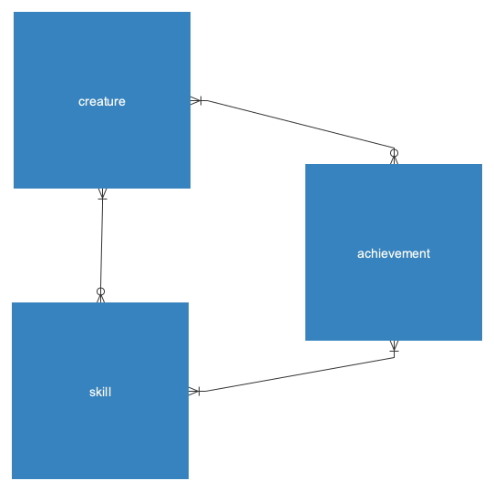
Conceptual Model

Slide 87
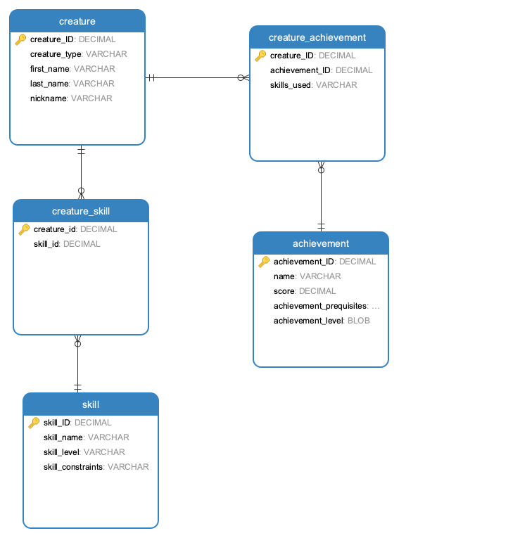

Slide 88
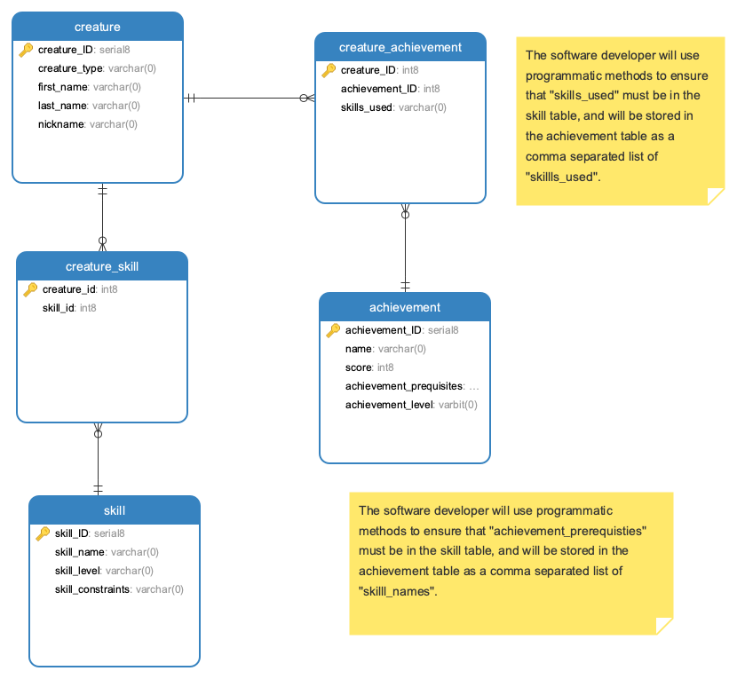

Slide 89
Heuristic Methods: Object Oriented Analysis and Design
State and Behavior
Data
Code / Methods
Integration / Cohesion & Coupling

Slide 90
Formal Methods
Safety Critical Systems
Systems that must be maximally deterministic
Mathematically verifiable

Slide 91
Prototyping Methods
What is a prototype?
Styles:
Throwaway
Evolutionary
Executable Specification
Notes:
Discuss value systems associated with each

Slide 92
Prototyping Methods
Examples of prototyping targets:
Requirements specification
Architectural design element
Human-machine user interface

Slide 93
Prototyping Methods
Evaluation techniques:
(Depends on the reason for prototyping)
Evaluated against implemented software
Evaluated against target set of requirements
Serve as a model for software development

Slide 94
Agile Methods in Historical Context
1990’s
From a desire to reduce overhead associated with plan-based methods (“waterfall”) **readings
Agile founders were concerned with values and principles rather than rigid, codified methodologies **readings
** Also Historical and comparative readings

Slide 95
Agile Methods
Typical characteristics of agile methodologies:
Short, iterative development cycles
Working product each iteration
Self-organizing teams
Refactoring
Test-driven development
Close customer involvement

Slide 96
Agile Methods: Rapid Application Development (RAD)
Notes:
Data

Slide 97
Agile Methods: eXtreme Programming (XP)
Notes:
Plan
Build
Test
USEr stories

Slide 98
Agile Methods: Scrum
Notes:
User stories with a manager

Slide 99
Agile Methods: Feature-Driven Development

Slide 100
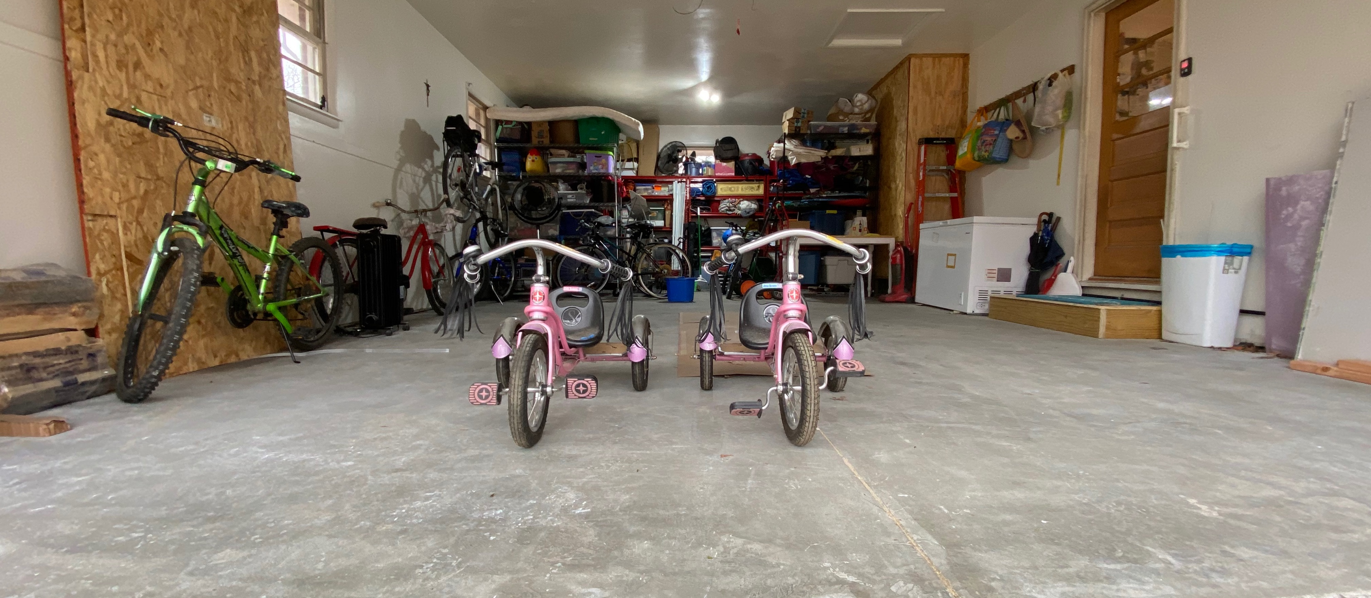
Done!

